Slide 1
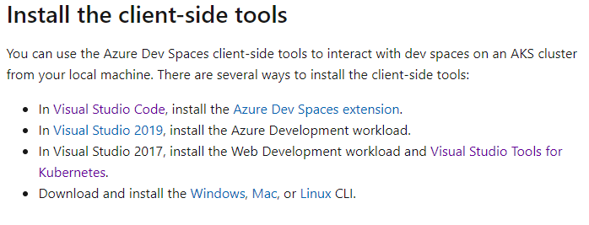

Slide 2
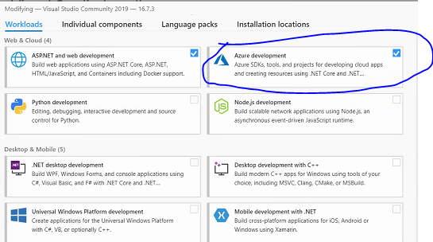

Slide 3
AKS with Azure Dev Space
Azure Dev Spaces provides a rapid, iterative Kubernetes development experience for teams in Azure Kubernetes Service (AKS) clusters. Azure Dev Spaces also allows you to debug and test all the components of your application in AKS with minimal development machine setup, without replicating or mocking up dependencies.

Slide 4
Azure Dev Spaces reduces the effort to develop, test, and iterate your Kubernetes application in the context of your AKS cluster. This reduction in effort allows developers to focus on the business logic of their applications and not configuring their services to run in Kubernetes.
With Azure Dev Spaces, you can connect your development computer to your AKS cluster, allowing you to run and debug code on your development computer as if it were running on the cluster. Azure Dev Spaces redirects traffic between your connected AKS cluster by running a pod on your cluster that acts as a remote agent to redirect traffic between your development machine and the cluster. This traffic redirection allows code on your development computer and services running in your AKS cluster to communicate as if they were in the same AKS cluster.
Azure Dev Spaces is supported only by AKS clusters in some regions. Mostly US and Canada Regions.

Slide 5
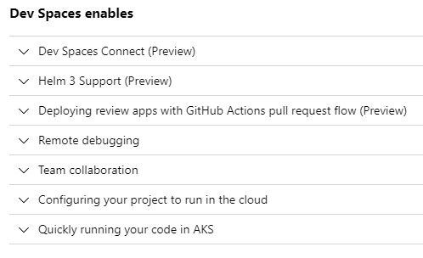

Slide 6
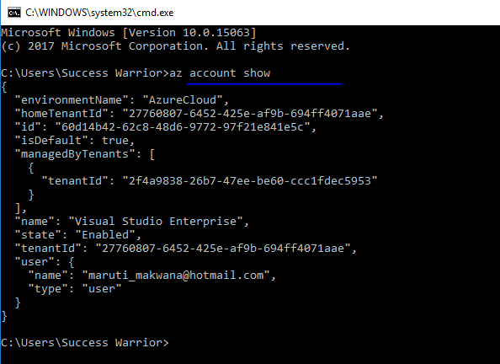
Use this subscription
For dev with AKS at client side

Slide 7
Deploy Azure kub cluster with service principal through portal

Slide 8
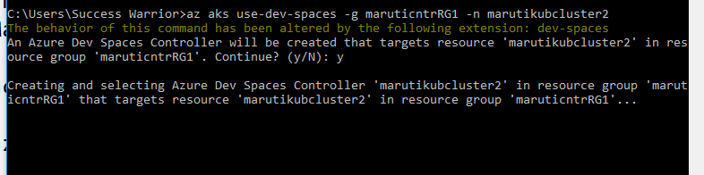
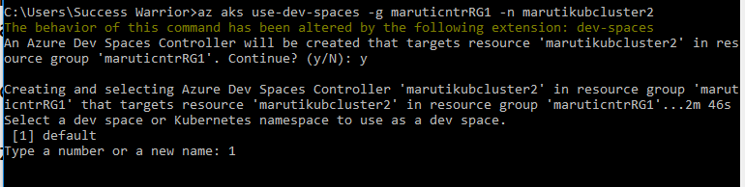
az aks use-dev-spaces -g LearningRG -n mysecondcluster

Slide 9
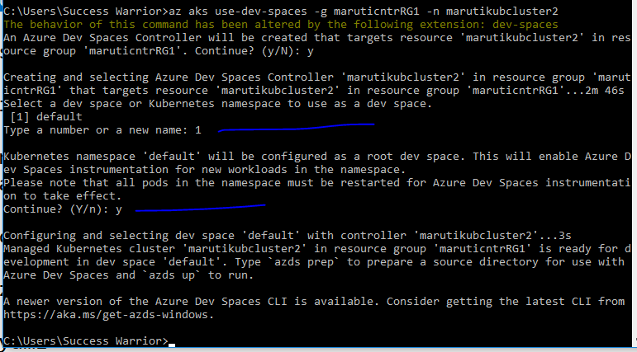

Slide 10
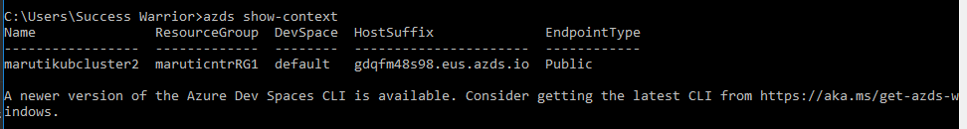

Slide 12
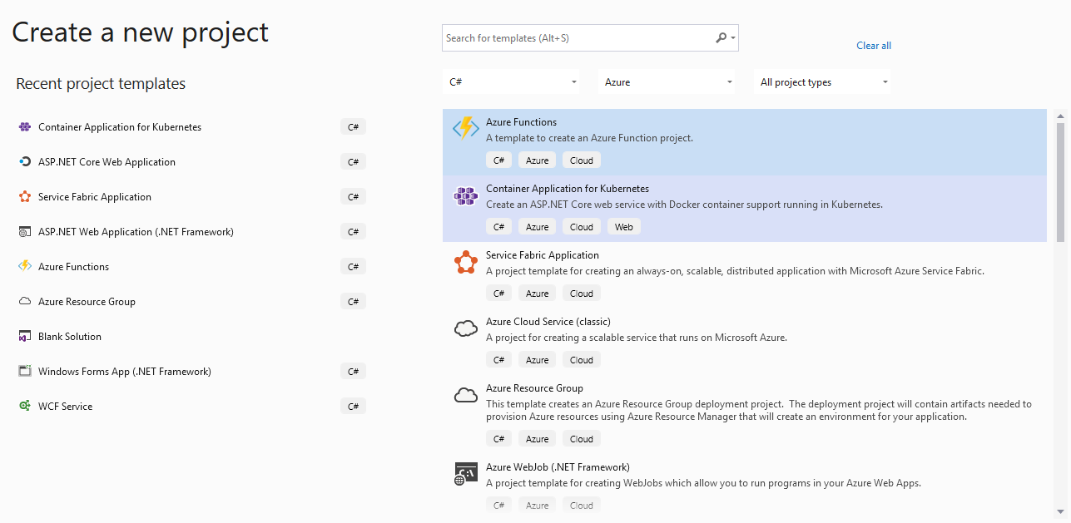

Slide 13
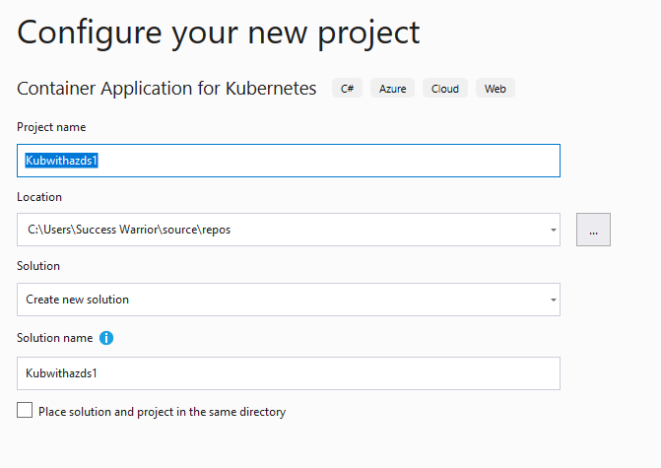

Slide 14
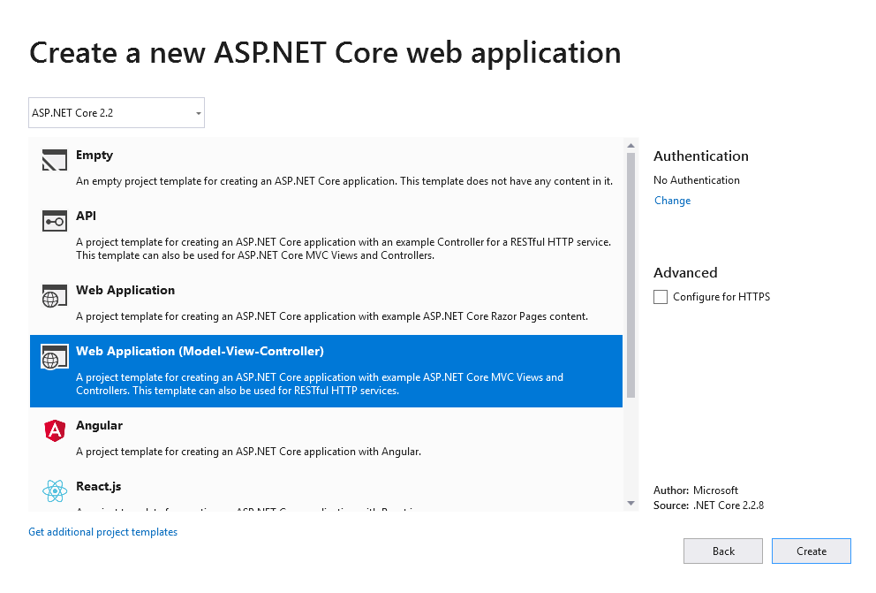

Slide 15
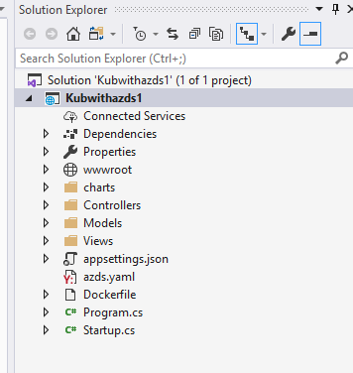

Slide 16
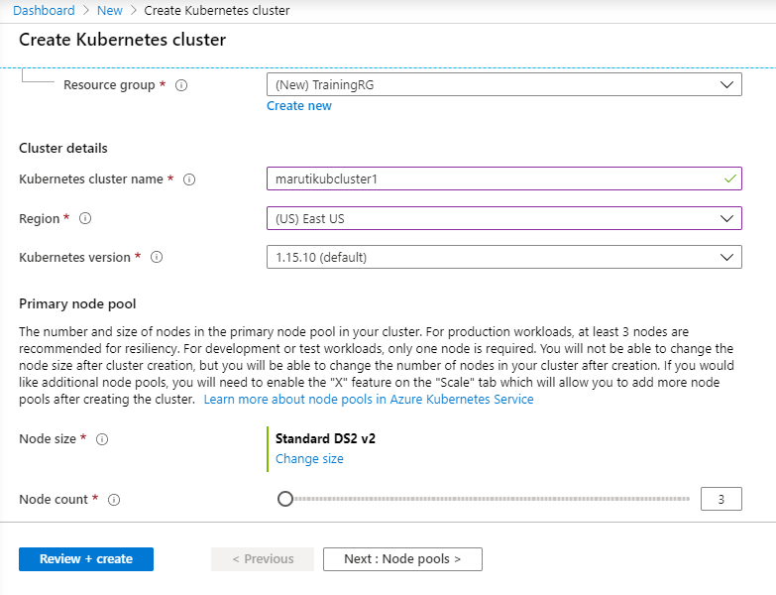

Slide 17
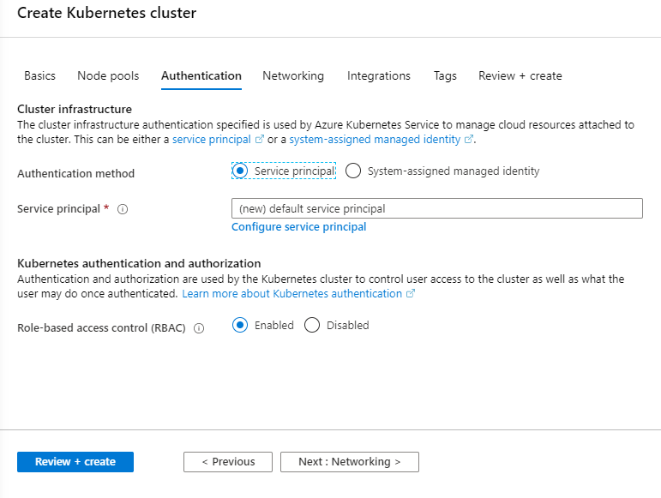

Slide 18
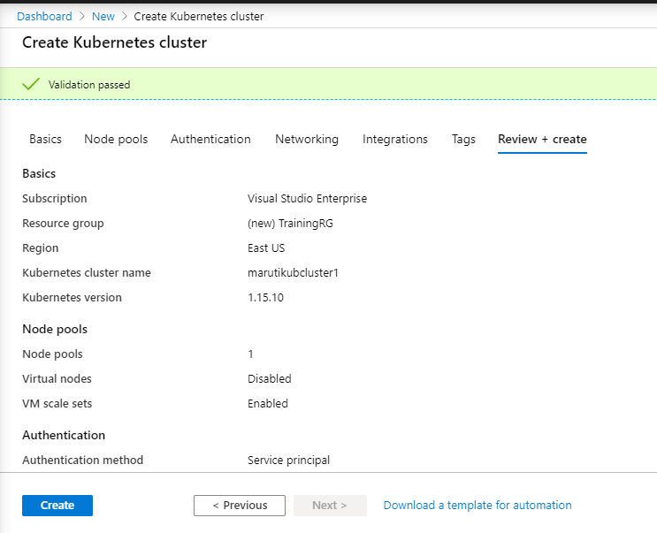

Slide 19
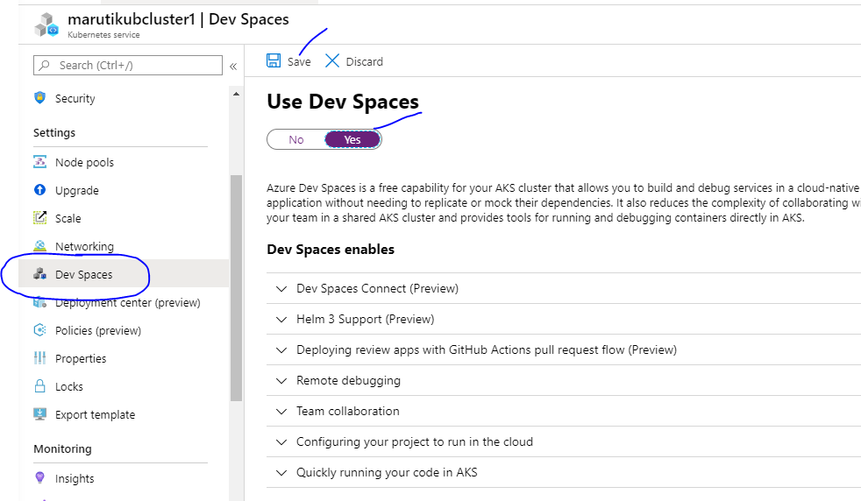

Slide 20


Slide 21
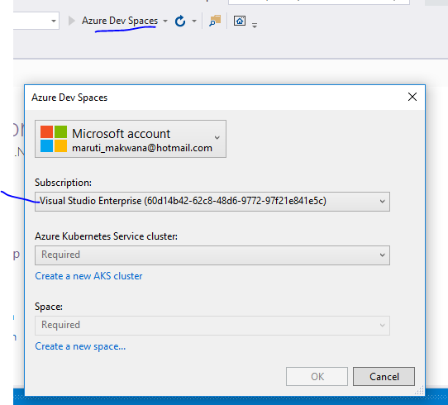
Create cluster on azure with
Azure dev space enable
and then select cluster
and dev space in Visual studio

Slide 22
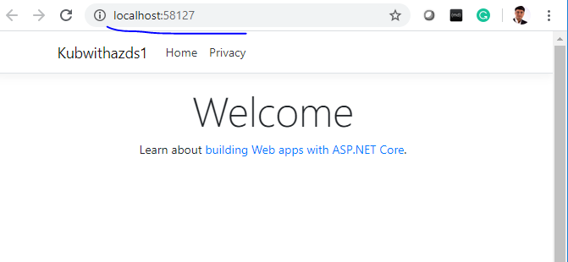

Slide 23
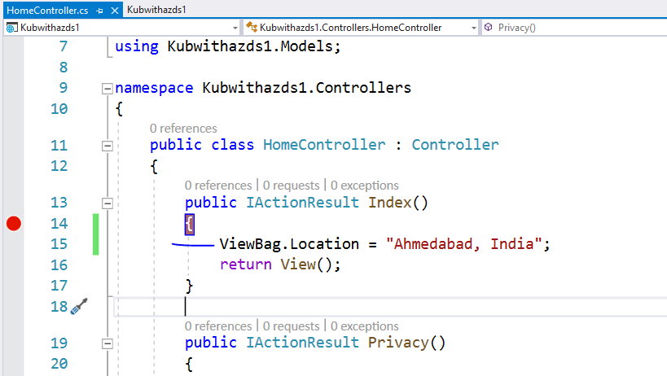

Slide 24
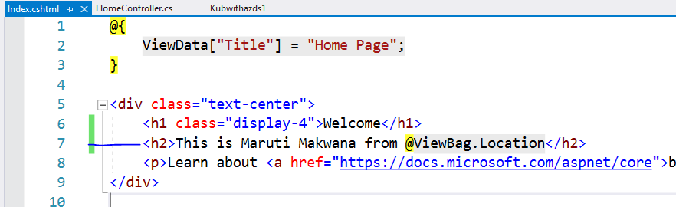

Slide 25
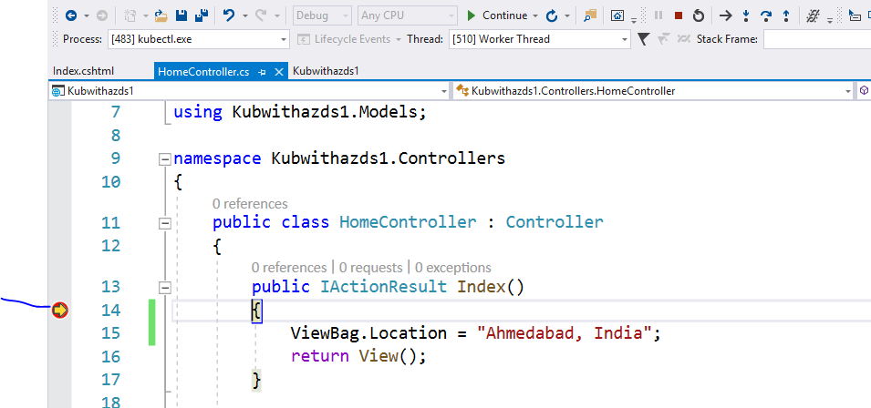

Slide 26
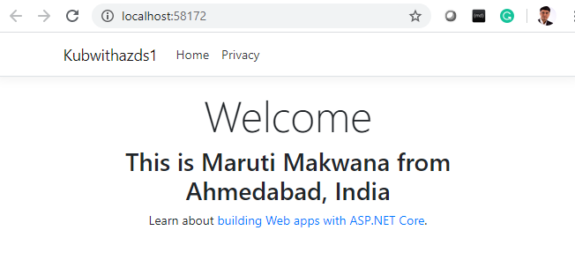

Slide 27
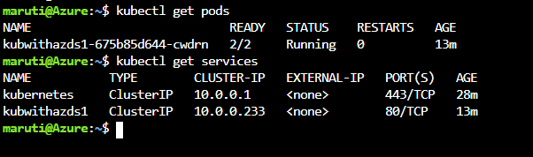

Slide 29
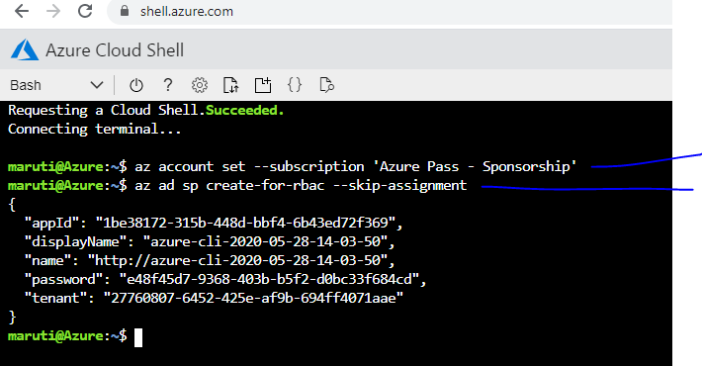
az account set --subscription 'Azure Pass - Sponsorship'
az ad sp create-for-rbac --skip-assignment

Slide 30
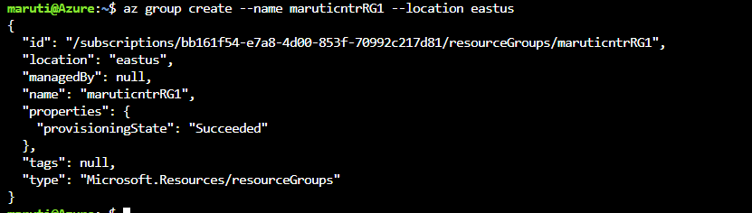
az group create --name maruticntrRG1 --location eastus

Slide 31
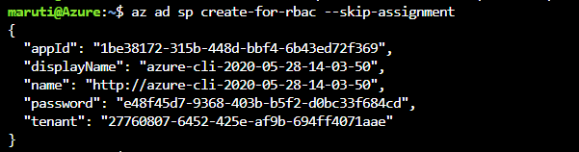
az aks create \
--resource-group maruticntrRG1 \
--name marutikubcluster2 \
-s Standard_B2s \
--node-count 1 \
--generate-ssh-keys \
--service-principal 1be38172-315b-448d-bbf4-6b43ed72f369 \
--client-secret e48f45d7-9368-403b-b5f2-d0bc33f684cd

Slide 32
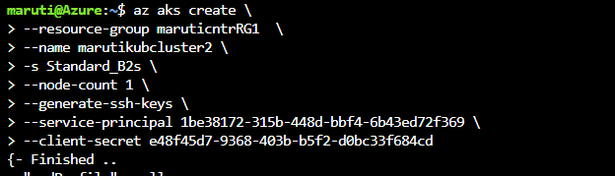

Slide 33
we need to enable Dev SPACE inside AKS cluster through Azure Portal
az aks use-dev-spaces -g maruticntrRG1 -n marutikubcluster2
azds remove -g maruticntrRG1 -n marutikubcluster2

